Slide 1

Resilience Patterns & Flyway Tool
By- Rupesh Patil
(Oct 2023)

Slide 2
Agenda
Microservice architecture Intro
Resilience Patterns
Circuit Breaker, Retires, Rate Limiter, Time Limiter and Bulkhead
Resilience4j Implementation
Database-migration tool - Flyway
Q & A

Slide 3
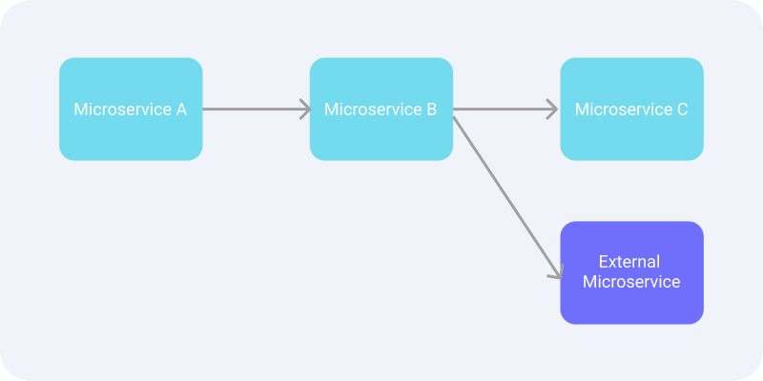
Microservice Architecture
If Microservice C is unavailable it impacts the Microservice B and Microservice A. – Domino Effect
The service which is waiting for another service is just wasting its resources.
In case of third party or external services, nothing to do except wait for their reply.
What can be done to prevent domino effect if the services are in our scope?

Slide 4
Resilience Patterns
Resilience4j is a lightweight fault tolerance library inspired by Netflix Hystrix
Circuit Breaker (After a number of failed attempts, we can consider that the service is unavailable/overloaded and eagerly reject all subsequent requests to it.)
Retry (automatically retry a failed call)
Rate Limiter (Allows limiting access to some service)
Time Limiter (Limit the amount of time spent calling a remote service)
Bulkhead (Limit the number of concurrent calls to a particular service.)
https://resilience4j.readme.io/docs/getting-started

Slide 5
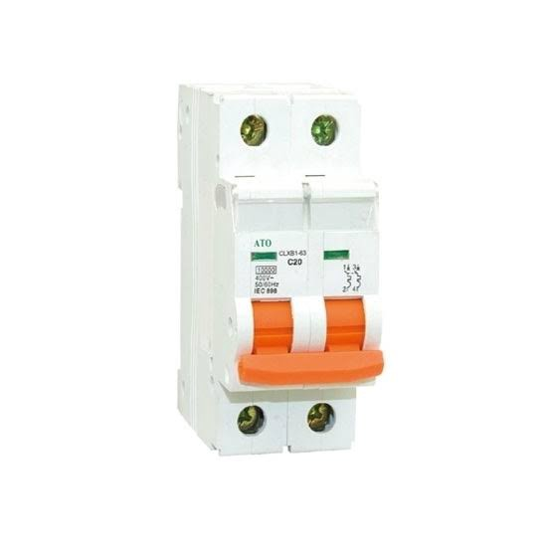
What is Circuit Breaker?
- Original idea comes from electronic engineering where it comes in a form of automatic switch that designed to protected electrical circuit from damage by excess of current in the circuit.
- The concept of a circuit breaker is to prevent calls to microservice when it’s known the call may fail or time out.
- This is done so that clients don’t waste their valuable resources handling requests that are likely to fail.
- Using this concept, we can give the server some spare time to recover.
- How do we know if a request is likely to fail? By Recording the results of several previous requests

Slide 6
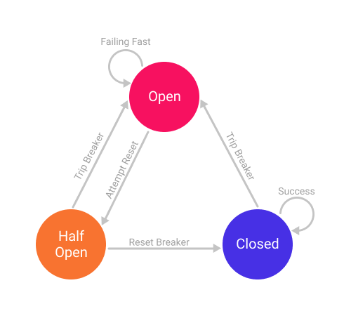
Circuit Breaker State
- Closed: when everything is normal. Initially, the circuit breaker is in a Closed state.
- Open: when a failure occurs. In this state fail-fast or fallback will be performed if available
When this state has passed a certain time limit will be moved to next state.
- Half-Open: several requests will be executed to find out whether the microservices that we are calling are working normally.
If successful, the state will be returned to the Closed state. However, if it still fails it will be returned to the Open state.

Slide 7
Circuit Breaker Type
Count-based: the circuit breaker switches from a closed state to an open state when the last N requests have failed or timeout
Time-based: the circuit breaker switches from a closed state to an open state when the last N time unit has failed or timeout.
In both types of circuit breakers, we can determine what the threshold for failure or timeout is
Suppose we specify that the circuit breaker will trip and go to the Open state when 50% of the last 20 requests took more than 2s
For a time-based, we can specify that 50% of the last 60 seconds of requests took more than 5s.

Slide 8
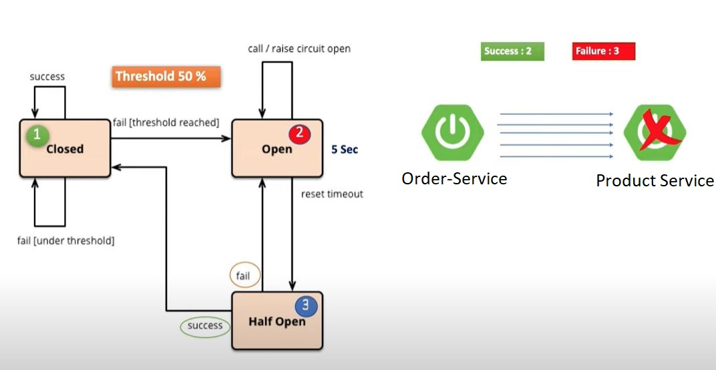
Resilience4j Circuit Breaker Conti..
https://resilience4j.readme.io/docs/circuitbreaker

Slide 9
Resilience4j Patterns
Resilience4j is a lightweight fault tolerance library inspired by Netflix Hystrix but designed for functional programming.
Features:
- Circuit Breaker (Fault Tolerance)
- Rate Limiter (Block too frequent requests)
- Time Limiter (Set time limit when calling remote operation)
- Retry Mechanism (Automatically retry failed operation)
- Bulkhead (Avoid too many concurrent requests)
- Cache (Store results of costly remote operations)
Add Required Dependencies and application.yml file to define configurations.

Slide 10
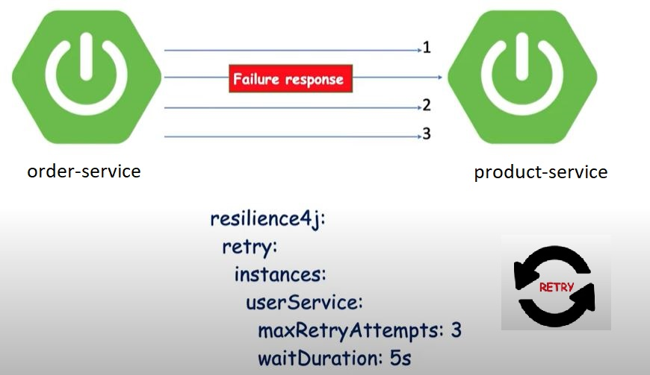
Resilience4j Retry
https://resilience4j.readme.io/docs/retry
Use case:
We know there are network latency issues in downstream/remote service, and we want to retry the call.

Slide 11
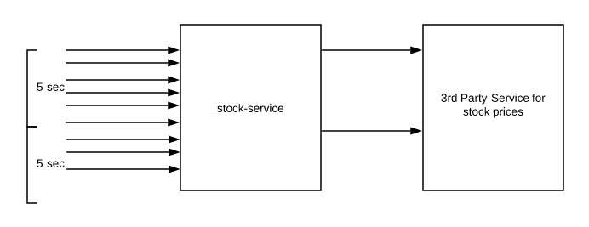
Resilience4j Rate Limiter
It’s a client-side rate limiting. As a consumer of a service, we want to ensure that we are not overloading the service provider.
This could happen if the service we are consuming is elastic. Instead of throttling our requests, the service provider might charge us extra for the additional load
Not only it is important to limit the load, but it also helps to eliminate the security concerns against malicious attacks (e.g., DoS or DDoS)
We can use Retry and Rate Limiter together
https://resilience4j.readme.io/docs/ratelimiter
https://reflectoring.io/rate-limiting-with-resilience4j/#what-is-rate-limiting

Slide 12
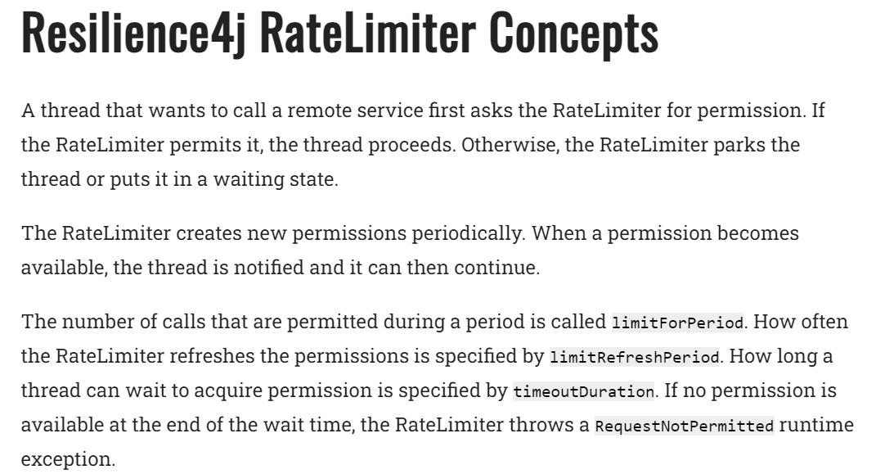

Slide 13
Resilience4j Time Limiter
Setting a limit on the amount of time we are willing to wait for an operation to complete is called time limiting
If the operation does not complete within the time we specified, we want to be notified about it with a timeout error or fallback default response.
One main reason why we would do this is to ensure that we don’t make users or clients wait indefinitely. A slow service that does not give any feedback can be frustrating to the user.
Resilience4j’s TimeLimiter can be used to set time limits (timeouts) on asynchronous operations implemented with CompleteableFutures. It lets us set a time limit on the asynchronous operation while retaining the benefit of being non-blocking when working with CompletableFuture in Java 8.
a) timeoutDuration: After this period time limiter activates and fails the call.
b) cancelRunningFuture: Boolean to cancel background tasks.
https://reflectoring.io/time-limiting-with-resilience4j/
https://resilience4j.readme.io/docs/timeout

Slide 14
Resilience4j Bulkhead
The idea behind bulkheads is to set a limit on the number of concurrent calls we make to a remote service
Resilience4j provides two types of bulkheads.
a) Semaphore — In this approach, we limit the number of concurrent requests to the service. It will reject the incoming requests once the limit is hit
b) ThreadPoolBulkhead — In this approach, we isolate a set of thread pool from system resources, using only that thread pool for the service
- Config:
a) maxConcurrentCalls : the max amount of parallel execution allowed by the bulkhead.
b) maxWaitDuration : the max amount of time a thread will be blocked for attempting to enter the maxConcurrentCalls count. Any additional requests will wait for the given duration. Otherwise, it will go with default/fallback method.
Note: Config is shared across API’s wherever we put @Bulkhead annotation
https://resilience4j.readme.io/docs/bulkhead
https://reflectoring.io/bulkhead-with-resilience4j/

Slide 15
Flyway
Flyway is an open-source tool for version controlling database. It’s like the Git for the databases.
Flyway enables you to write SQL scripts for your schemas and tables and version them to ensure consistency and offers the ability to roll back as needed.
By default, Flyway will check for migration files inside src/main/resources/db/migration. If you used the Spring Initializer to add Flyway, this directory has already been created for you. If not, create that directory.
The migration file should be named as such: V1_1_0__Create_customer_table.sql etc
Alternate tool: https://www.liquibase.org/get-started/quickstart
https://flywaydb.org/documentation/command/undo
Example: Refer Customer Service and go through application.props file
Demo: First run Create Table script, next run update table script and run insert script.

Slide 16
Q & A
Thank you !!

